Slide 1
ICEPS: Compact, all-purpose, USB 2.0 based small satellite system core
2nd IAA Latin American Symposium on Small Satellites:
Advanced Technologies and Distributed Systems
Main Author
Prof. Ronnie Nader, Cosmonaut, Space Operations Division, Chief Engineer Ecuadorian Civilian Space Agency (EXA), Ecuador.
Co-Authors
Mr. Gerard Nader, Engineering Division – Ecuadorian Civilian Space Agency (EXA), Ecuador
Mr. Jules Nader, Engineering Division – Ecuadorian Civilian Space Agency (EXA), Ecuador.

Slide 2
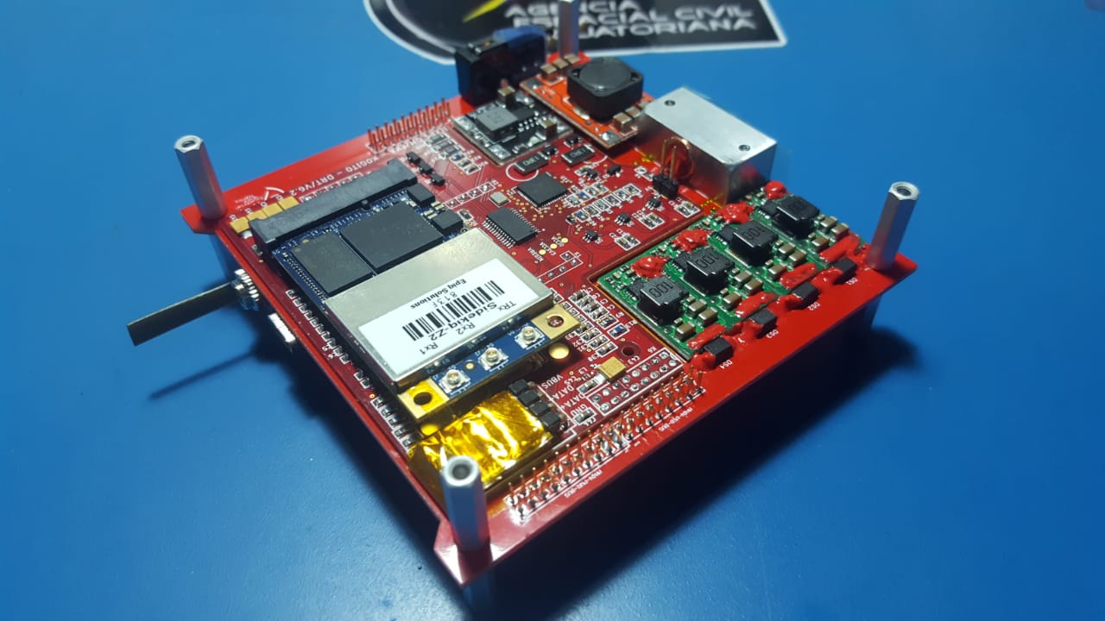
ICEPS USB 2.0 Satellite System Core
Background
Design
Physical System Overview
Functional System Overview
Modularity
In-orbit Demonstration and Future Development
Conclusions

Slide 3
ICEPS USB 2.0 Satellite System Core
BACKGROUND:
In 2015 EXA was awarded a 12 year contract by the Irvine Cubesat STEM Program (ICSP) from USA, for a project meant to send a total of 12 satellites on various student-training missions.
In IRVINE01 and IRVINE02 missions, EXA provided various hardware modules including the deployable solar arrays, batteries, laser communications and UMPPT modules.
A completely redesigned and upgraded spacecraft bus was requested for IRVINE03 as a new and modernized version of PCEPS, the technology used on Ecuador’s first satellite, which is now called ICEPS, an All-in-one OBC/Radio SDR/EPS/Laser comms, SATELLITE SYSTEM CORE , in one card.

Slide 4
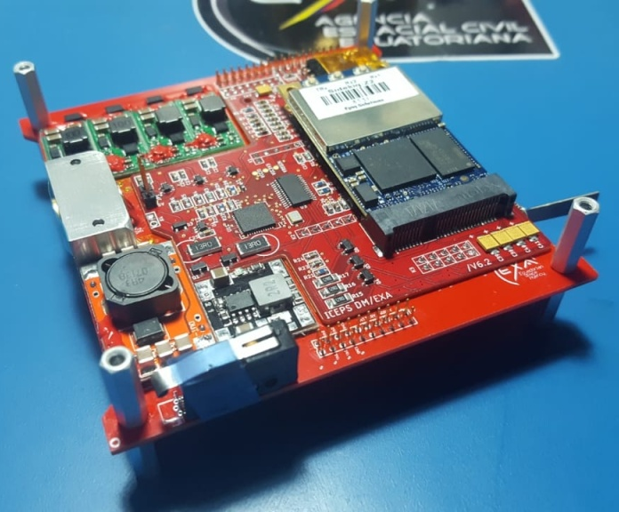
ICEPS USB 2.0 Satellite System Core
DESIGN:
USB architecture
Solar charge (UMPPT)
Laser Communications Module
Power Supply
High Capacity SSD Storage
Epiq Sidekick Z2 OBC
Software Defined Radio
DSA Deployment Control
Sensors and actuators

Slide 5
ICEPS USB 2.0 Satellite System Core
ICEPS
Digital Module
Batteries
Structure
PROPULSION
3 Power Cores
Shielding
Solar Arrays
UMPPT/Charger
LASER coms
Main Hub
Secondary Hub
GPS
XRAY
ST Camera
MUX 4
Epiz Z2: OBC/SDR
Propulsion Module
Laser Modulator
FLASH DRIVE
External Interface
Internal Sensors
ADC Sensors
Science Module
Sband Antenna & PA
ICEPS System Core
DSA control
A/S & RBL
Integrated Magnetorquers
IRVINE-03 – PHYSICAL SYSTEM OVERVIEW

Slide 6
ICEPS USB 2.0 Satellite System Core
IRVINE03
Structure
ICEPS System Core
Shields
Solar Arrays
Sband Antenna & PA
Power
Digital Module
Science Module
3V3 PWC
5 PWC
12 V PWC
UMPPT/Charger
LASER coms
A/S & RBL
SRadio1
SRadio2
IMU
Sensor Matrix
OBC
USB Hubs
GPS
XRAY
SSD Storage
ST Camera
Propulsion Module
Batteries
Integrated Magnetorquers
IRVINE-03 – FUNCTIONAL SYSTEM OVERVIEW

Slide 7
MAIN USB HUB
2NDARY USB HUB
USER PORT
USER PORT
Z2 OBC
PROPULSION/ LOCOMOTION
ADCS
EXT USB CONNECTOR
USER PORT
USER PORT
LASER COMM
ADC NET
ADC1 16 I/Os
ADC2 16 I/Os
SSD DRIVE
ICEPS USB 2.0 Satellite System Core
USB Architecture
From I2C/SPI to USB 2.0
The USB core has up to 14 ports, 8 of them used by ICEPS, 6 available for user.
The OBC is on upstream port of main USB hub
The ADC network has room for 32 GPIOs
USB-C connector is backward compatible and normally uses USB 2.0 protocol.

Slide 8
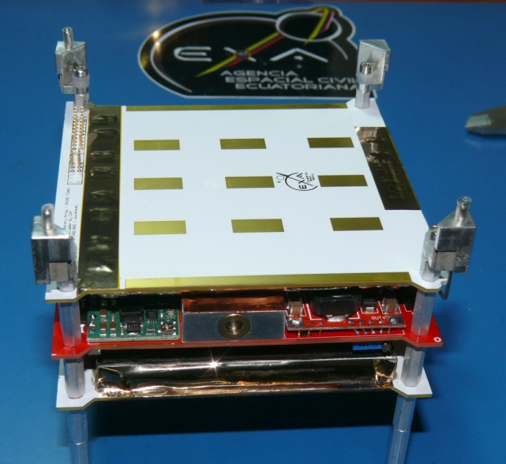
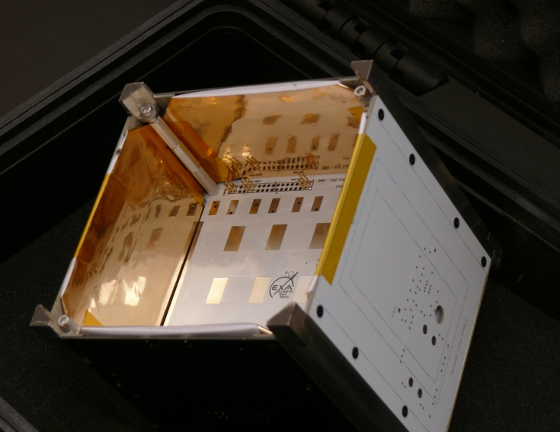
ICEPS USB 2.0 Satellite System Core
USB bus resilience against radiation
To mitigate the impact of SLEs and SUEs in the OBC, the ICEPS board is encased between 2 BA01/S battery packs
The second radiation protection is the SEAM/NEMEA shielding MLI that protects all the sides of the cubesat.
The Space Environment Attenuation MLI (NEMEA) is an MLI of 27 layers that has spaceflight heritage since 2013 and has been demonstrated very effective in regulating radiation, temperature and plasma environments.

Slide 9
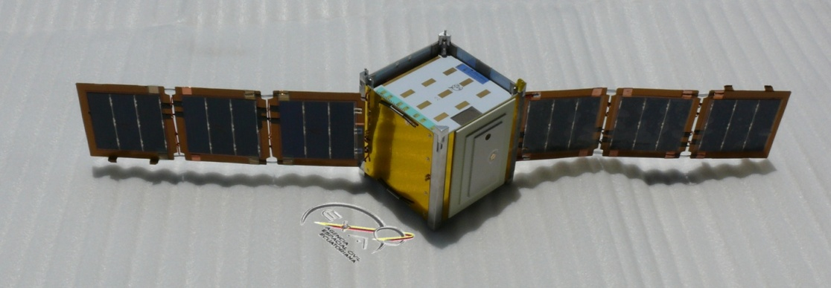
ICEPS USB 2.0 Satellite System Core
Solar charge using Unified Maximum Power Point Tracking
The power generation architecture of IRVINE-03 includes 2 Deployable Solar Arrays (DSA), each one with two nanomorphodynamic actuator sets
The DSAs have two sides and each one is equipped with solar cells, hence the need for four UMPPT channels, in order to harness as much power as possible without sacrificing the other partially illuminated side.
The UMPPT bus to which the channels are connected feed the charging circuit to which the battery arrays are directly connected.

Slide 10
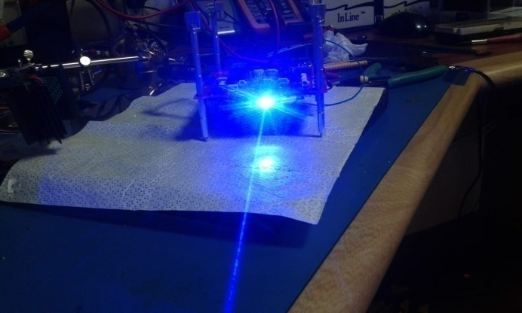
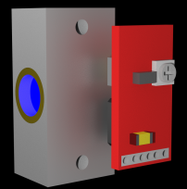
ICEPS USB 2.0 Satellite System Core
Laser Communications Module PLM02
This laser module has higher data transfer rates that can handle large payload data sizes and can potentially achieve downloads as big as 100MB in 1 to 5 minutes.
The laser communications module can be set to transmit as low as 115Kbps and as high as 10Mbps.
The wavelength of the communications laser is 450nm or 405nm.

Slide 11
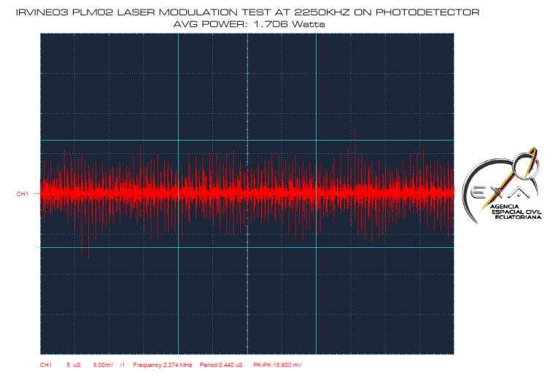
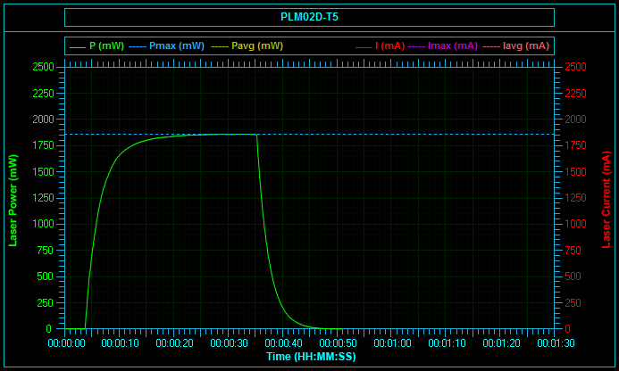
ICEPS USB 2.0 Satellite System Core
PLM-02 Power plot modulation 2.25Mbps at 1.7 W

Slide 12
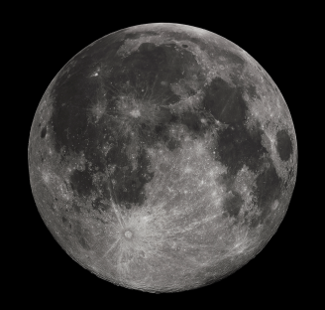
ICEPS USB 2.0 Satellite System Core
PLM02: Pointing accuracy vs. Power flux density
High accuracy pointing at 0.5W/1550nm/1 meter telescope
Beam aperture: 0.0009 deg Footprint diameter: 6.3 km
Photon flux density at target area: 2.5E+18
Energy/photon: 1.40E-19
Resulting Energy Density at tgt area: 0.35 J
Power flux at detector: 1.07E-08 J
High Power delivery at 7W/450nm/1 meter telescope
Beam aperture: 1.5 deg Footprint diameter: 10,472 km
Photon flux density at target area: 6.56E+18
Energy/photon: 4.90E-19
Resulting Energy Density at tgt area: 3.22 J
Power flux at detector: 3.54E-14 J

Slide 13
ICEPS USB 2.0 Satellite System Core
512GB of high speed, radiation tolerant SSD storage
ICEPS can be fitted with a minimum of 32GB and a maximum of 512GB of high speed (60 MB/s read/write) USB 2.0 SSD storage, which is natively radiation tolerant made by Samsung.
In addition to that native tolerance, the SSD is protected by its own radiation shielding, encased between 2 battery banks and protected by the NEMEA shielding.
The SSD is connected to a high priority USB 2.0 channel, so it can drive at a top speed of 480Mbps if needed.

Slide 14
ICEPS USB 2.0 Satellite System Core
Power Supply
ICEPS has several power rails including:
One 5V@3A rail
One adjustable 12V@3A rail (can be set to other voltages, from 5 to 30V
1 to 3 redundant 3V3@3.6A rails
One unregulated 4.2~3.6@12A rail
One auxiliary APU port
Each P/C can be controlled by the OBC independently
The whole bus is capable, 50W Nominal (continuously), 65W Maximum, 100W peak for 2.5 sec.
Battery Array
5V@3A POWER CORE
3V3@3.6A POWER CORE
12V@3A POWER CORE
AUXILIARY POWER UNIT

Slide 15
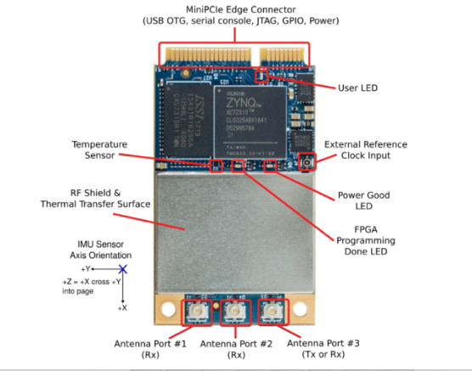
ICEPS USB 2.0 Satellite System Core
Epiq Sidekiq Z2 OBC
ICEPS computing core is an Epiq’s Sidekiq Z2:
Dual-core ARM Cortex A9 CPU running up to 733 MHz
Linux computer running IIOS
512 MB of DDR3L RAM
32 MB of QSPI flash storage for uboot bootloader, Linux kernel, and root file system
USB 2.0 main network port
Internal independent watchdog and temp. sensor
Internal IMU, 6 axis sensor, ADCS ready

Slide 16
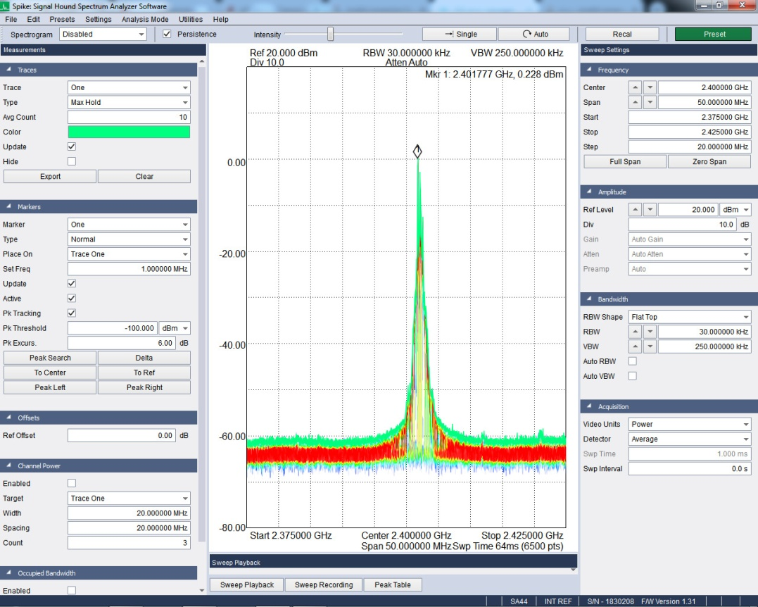
ICEPS USB 2.0 Satellite System Core
Z2 Software Defined Radio OBC
The ICEPS’s Sidekiq Z2 is an SDR Engine:
SDR range: 70Mhz to 6GHz
EIRP: +28.5 dBm w/ext. LNB
Sensitivity: -110 dBm
Antenna ports: 2 RX
1 Transceiver (TX/RX)
Complete libraries in C++ and Linux programming environment.
Automated RF Switch integrated into the S/C bus

Slide 17
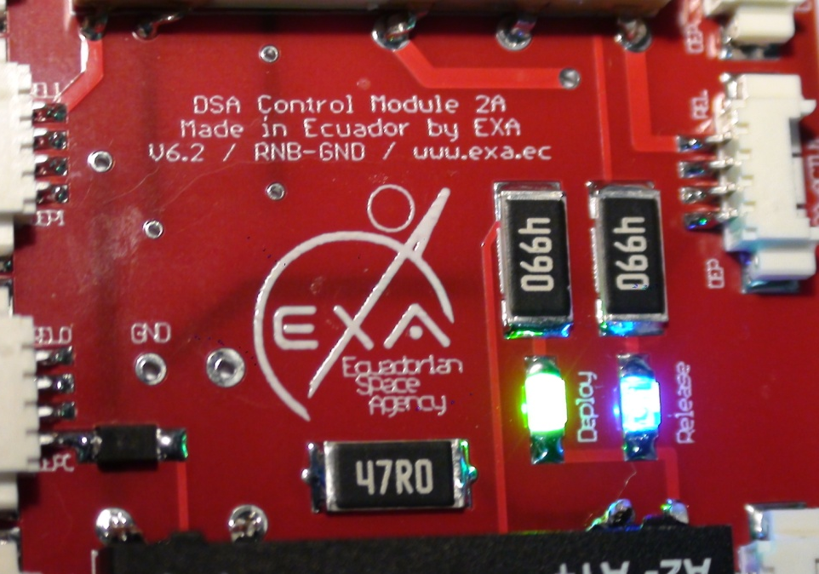
ICEPS USB 2.0 Satellite System Core
DSA Deployment Control
The Deployable Solar Array Deployment control allows the user to rely on ICEPS for deployment and release control.
Just one simple command from the user.
DSA/DC automates the release and deploy sequence.
If using EXA DSA arrays, release/deploy is guaranteed.
Natively manages artificial muscles and Nitinol-based R/D devices
Can also manage thermal knife user devices using up to 15W.

Slide 18
ICEPS USB 2.0 Satellite System Core
Sensors and Actuators Control
ICEPS has 24 internal sensors:
Laser(1), OBC(1), External (2) and battery(2) temperature
Solar panel voltage (4)
Power rails (3) voltage
Solar array deploy/release (4)
UMMPT bus (1)
6 Axis gyroscope (6)
And 4 actuators:
DSA R/D sequence, Power amplifier, power rail control (2)

Slide 19
ICEPS USB 2.0 Satellite System Core
MODULARITY
ICEPS can be configured from an EPS configuration only to a full System Core configuration at user request:
Power rails, 1 to 6, user configurable output
Solar channels, 1 to 4
Solar charging manager, single or dual
Release/Deploy circuitry, 0 to 1
Laser comm module, 0 to 1
Onboard OBC, 0 to 1
Battery arrays, 1 to 4
USB 2.0 bus or just GPIO

Slide 20
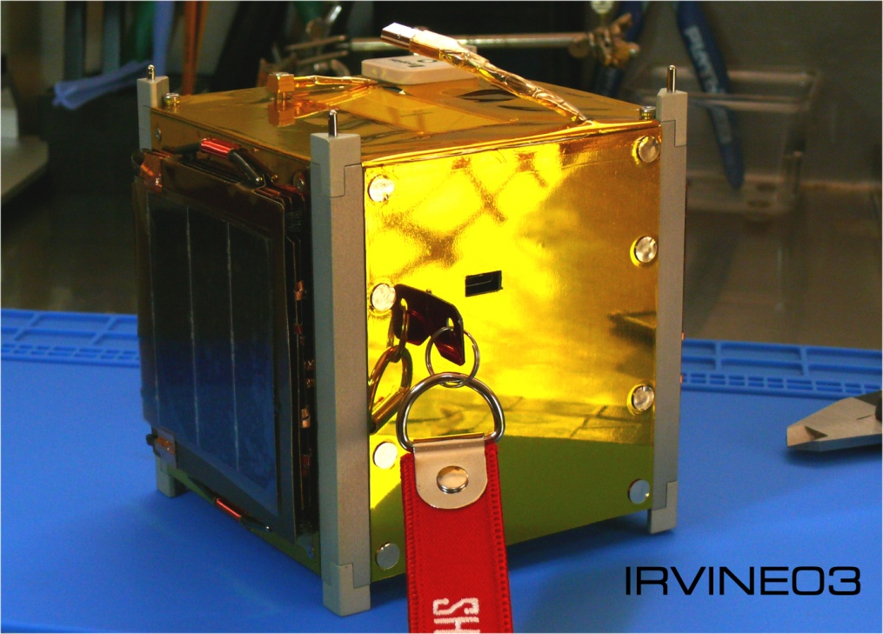
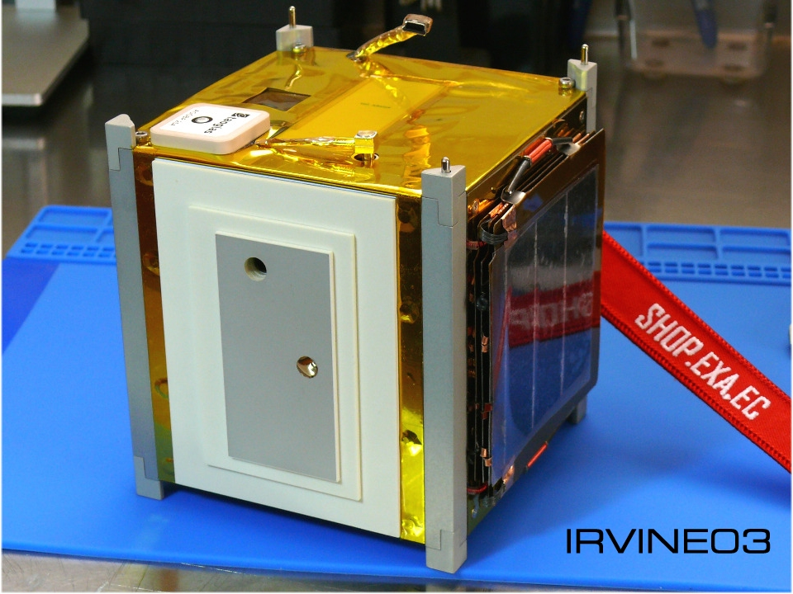
ICEPS USB 2.0 Satellite System Core
IN-ORBIT DEMONSTRATION
ICEPS ONBOARD IRVINE03 TO BE LAUNCHED ON NASA ELaNA SLOT IN Q2/2020

Slide 21
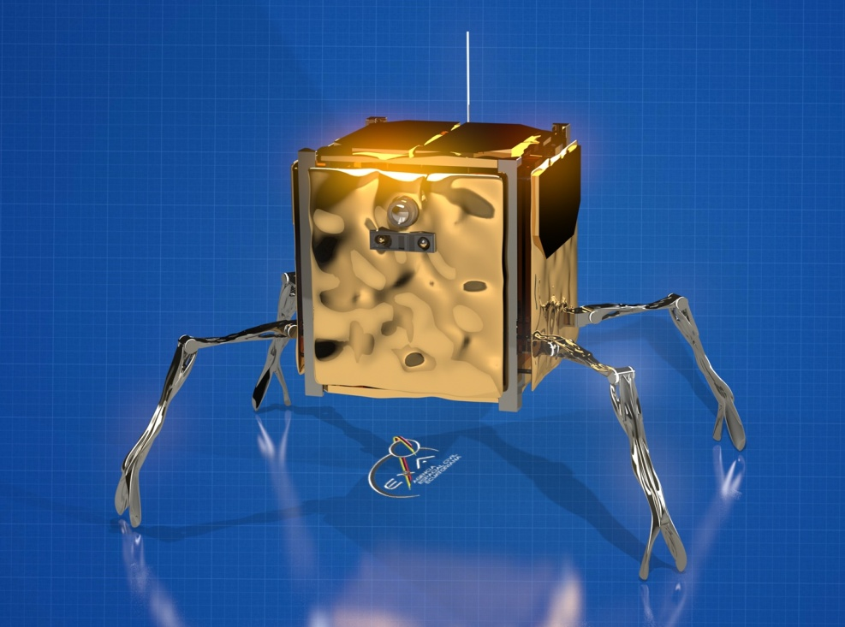
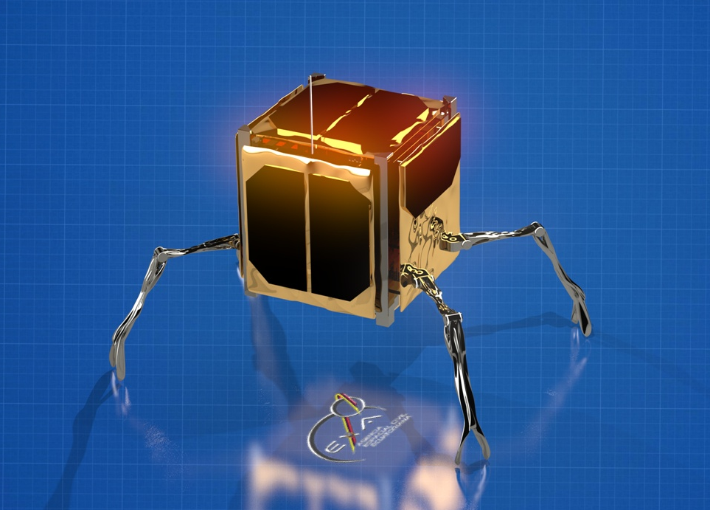
ICEPS USB 2.0 Satellite System Core
LUNAR DEMONSTRATION
ICEPS ONBOARD QBWALKER TO LAND ON THE MOON ON BOARD ASTROBOTIC’S PEREGRINE IN Q3/2021

Slide 22
ICEPS USB 2.0 Satellite System Core
CONCLUSIONS
Pros:
Can serve missions from 1U to 24U.
Takes the cubesat community beyond the limitations of the I2C, SPI, CAN-bus etc.
High computing power, throughput, high capacity storage and high speed laser communications are included. SDR naturally embedded into the system.
Modularity allows great configuration and cost flexibility.
USB bus enables cubesats to interface with the millions of devices on the ground that have long since standardized to it.
Cons:
Needs heavier radiation shielding, but EXA’s NEMEA solves this need
The payload development needs to strictly follow USB 2.0 developing guidelines

Slide 23
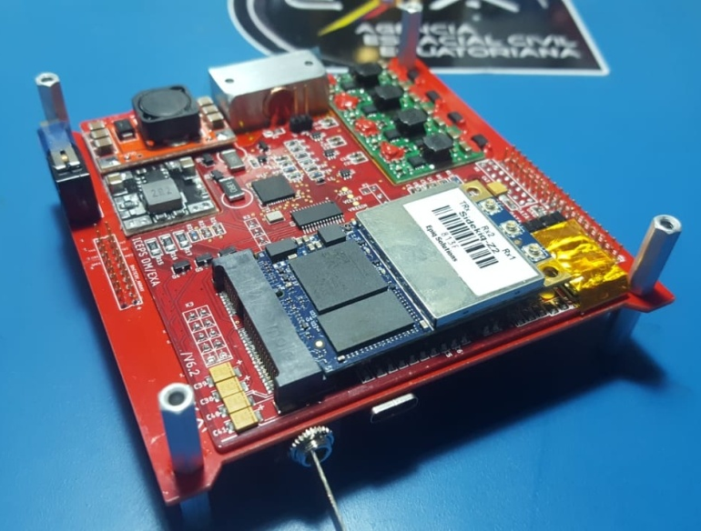
ICEPS USB 2.0 Satellite System Core
Thank you for your attention
info@exa.ec

